Slide 1

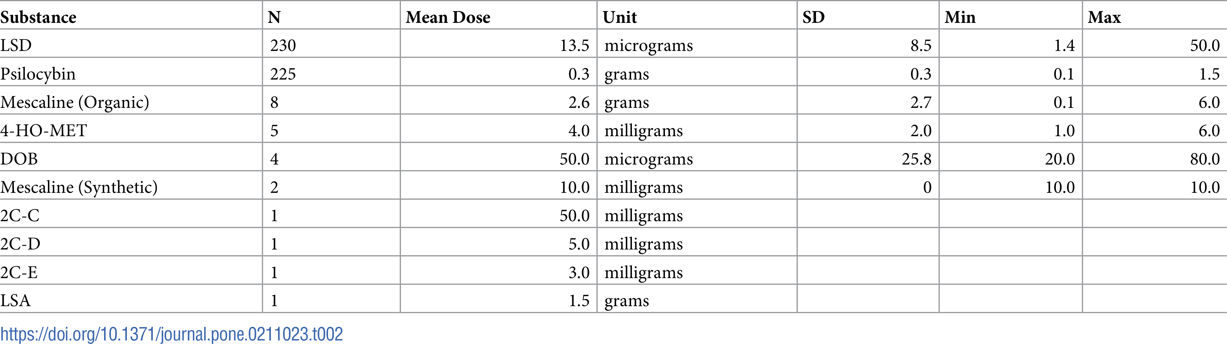
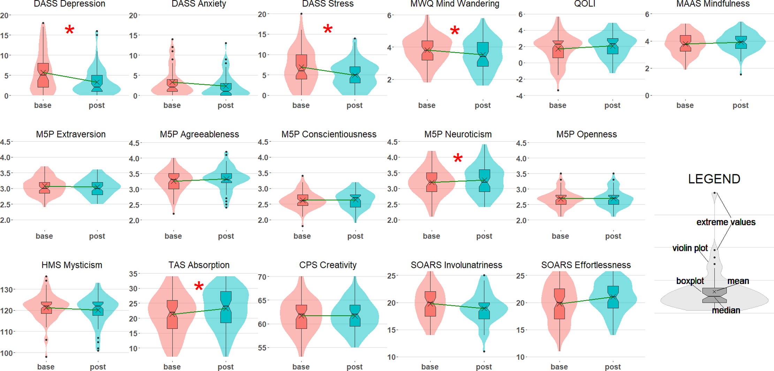
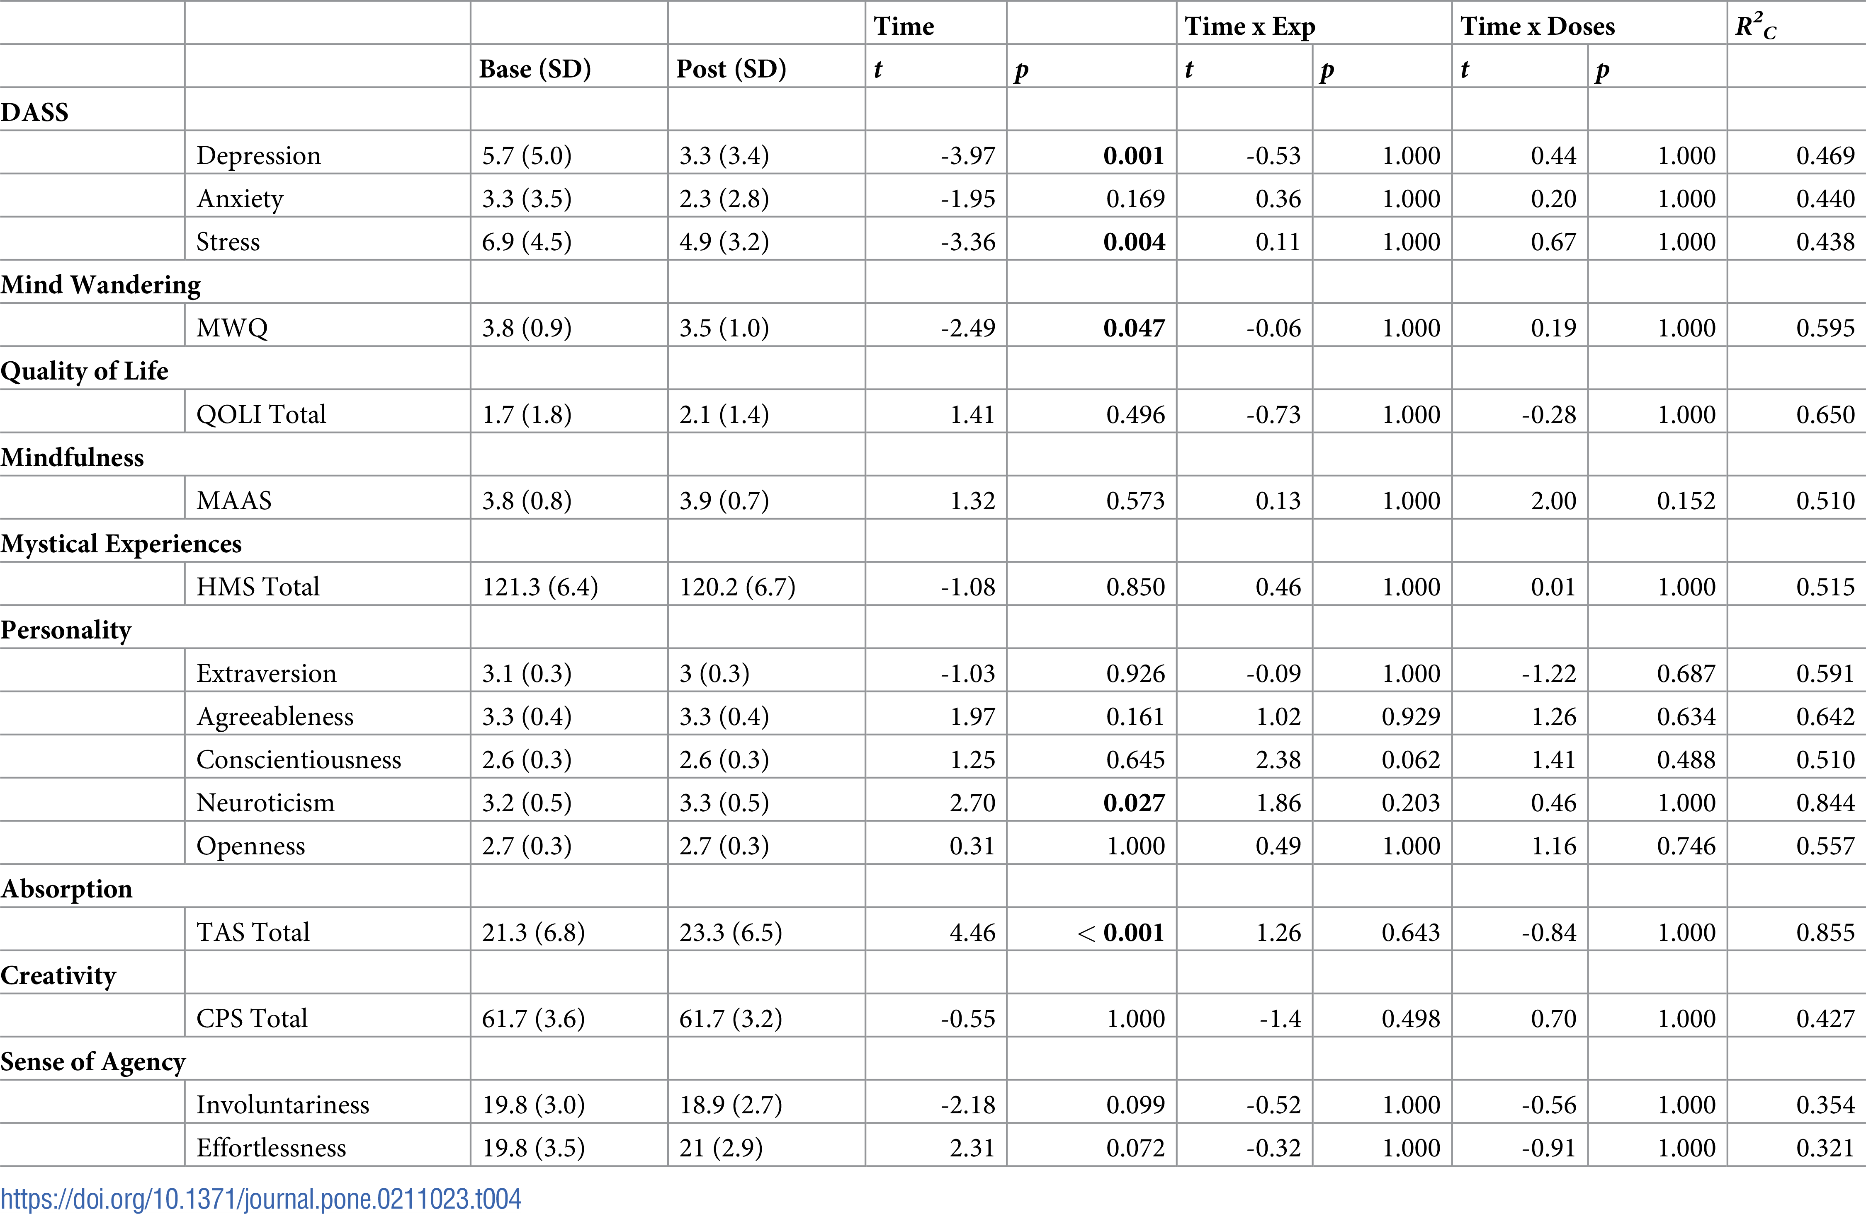
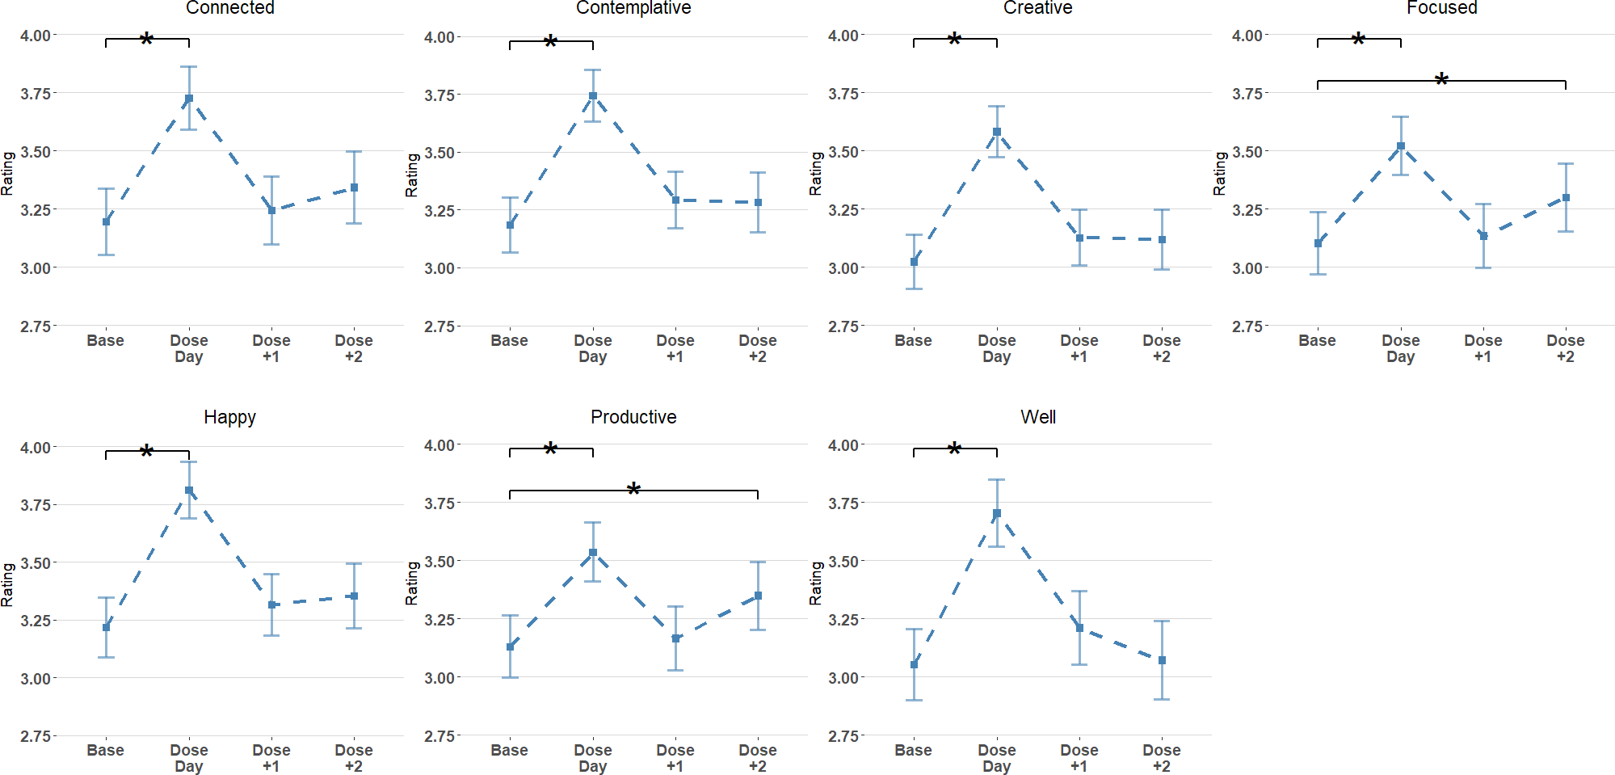
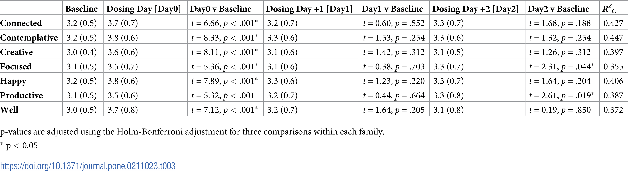
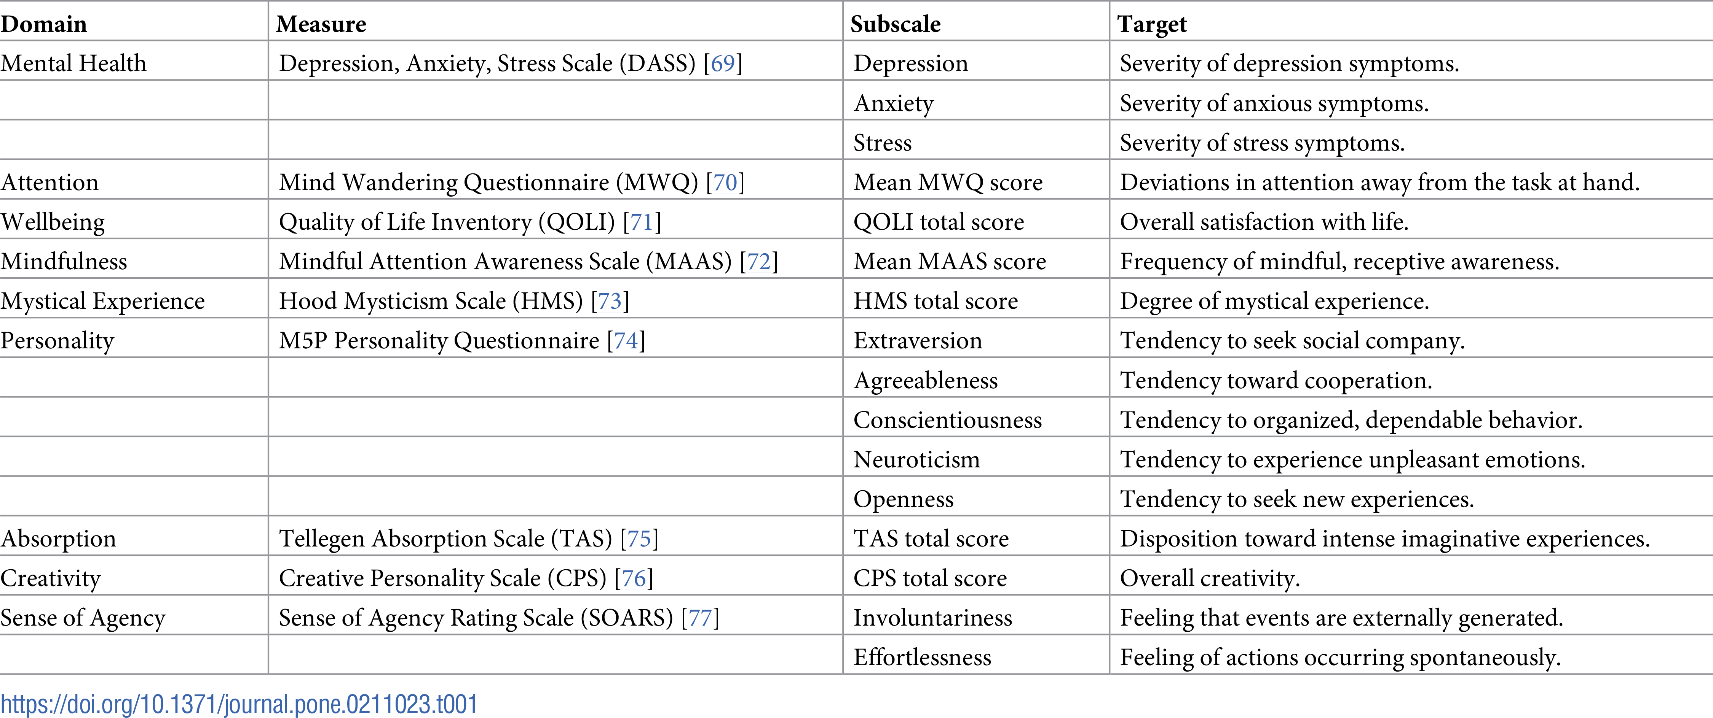
The Health Benefits of Microdosing Psychedelics
Vince Polito and Richard J. Stevenson
Macquarie University, Department of Cognitive Science, Department of Psychology, Sydney, Australia
vince.polito@mq.edu.au, richard.stevenson@mq.edu.au
Introduction:
Microdosing psychedelics is the act of consuming a small dose of a psychedelic drug like psilocybin or lysergic acid diethylamide, known as LSD, on a regular basis (1). Psychedelics work by targeting the serotonin 2A brain receptor, which disintegrates the normal network connectivity and causes mind-altering effects (1).
Unfortunately, there has been no effective study on microdosing because of the government restrictions on psychedelics (3). The only way an experiment would be effective is if there is a large group of participants of various ages and backgrounds who follow the regimen for many months to years in a controlled environment in which placebos are given as well.
Polito and Stevenson believe that microdosing may affect absorption, creativity, mental health, wellbeing, mindfulness, personality, sense of agency, attention, and mystical experiences (2). They will track the changes in these domains over the course of 6 weeks by using a rating system based on the Likert scale, a five point range from strongly disagree to strongly agree (2).
Out of the 63 participants, 20 had never microdosed before. On average, the participants microdosed about 5 times during the study, with the average time between doses being 6.7 days.
There were 98 participants who sent in daily ratings and their data was used to create graphs that shown in the figure below. In each variable, p < 0.001 on the dose day. On day 1 after the dose, all p-values were between 0.2 and 0.8. On day 2, only two variables, focused and productive, had p-values under 0.05.
In the long-term study, which compared the batteries from pre- and post-study, the original nine domains were tested for 63 participants. A boxplot and violin plot was graphed for each section of the nine domains below.
The researchers also calculated p-values for each variable. DASS Depression (mental health domain; p = 0.001), DASS Stress (mental health domain; p = 0.004), MWQ (attention domain; p = 0.047), Neuroticism (personality domain; p = 0.027), and TAS Total (absorption domain; p < 0.001) had p-values under 0.05.
This table shows how many participants used each substance and the dose size statistics.
Baseline and post-study scores compared. Starred (*) variables are statistically significant.
Methods:
To find participants, Polito and Stevenson recruited people that were active on microdosing media communities from reddit, bluelight, and facebook. A total of 98 participants completed the baseline questionnaire and sent a minimum of one daily report of microdosing psychedelic.
Only 63 of these people did the post-study questionnaire and were used to analyze long-term effects. Out of these 63, a majority were male (~78%), under 36 years old (~71%), and well educated with a postgraduate education (~72%). They were asked to complete a baseline and post-study battery, and a daily, short rating.
The format of the daily ratings was adapted from Fadiman’s protocol, a regimen of microdosing in which they would consume one dose every three days. In their daily rating, participants were asked to record which substance and dosage they had taken the day before and give a rating on the following feelings they had felt: contemplation, connectedness, focus, creativity, happiness, productiveness and wellbeing. In the batteries, participants were provided a series of statements in each of the nine domains tested. They responded on a four-point Likert scale for each statement.
This table shows the mean, t, and p-values on the long-term battery scores.
Conclusion:
This study shows researchers just the beginning of a new world of possibilities from microdosing psychedelics. Out of the nine domains tested, four of them had variables that were significantly changed during the experiment. Even though the results are not accurate given the circumstances, this study still proves that microdosing does impact people’s lifestyles and often improves their well-being. It is a great start to a subject that is difficult to test.
The daily ratings showing changes in feelings on baseline, dose day, and two days after dose day.
Results:
Throughout the study, participants had recorded microdosing on a range of substances including LSD, psilocybin, mescaline, 4-HO-MET, DOB, 2C-C, 2C-D, 2C-E and morning glory seeds.
Acknowledgment:
This research paper could not have been completed without the hard work shown by Vince Polito and Richard J. Stevenson. Their time and effort are greatly appreciated and acknowledged. Furthermore, the dedication shown by the participants in this study is appreciated as well. Their willingness to assist the scientific community by compromising some of their valuable time is admirable.
This table shows the numerical values of the figure above it. It shows the value of the dose day and two days after in comparison to the baseline.
References:
Kuypers, K. P. (2020). The therapeutic potential of microdosing psychedelics in depression. Sage Journals, 10, 1177.
Polito, V., Stevenson, R. J. (2019). A systematic study of microdosing psychedelics. Plos One, 14(2), 0211023.
Murphy, R. J., Sumner, R. L., Evans, W., Menkes, D., Lambrecht, I., Ponton, R., Sundram, F., Hoeh, N., Ram, S., Reynolds, L., Muthukumaraswamy, S. (2021). MDLSD: study protocol for a randomised double-masked, placebo-controlled trial of repeated microdoses of LSD in healthy volunteers. Trials, 22(1), 1-15.
This table shows each of the 9 domains that Polito and Stevenson believe will be affected by microdosing.

